Slide 1




Few shot Learning An Embarrassingly Simple Approach to Semi-Supervised Few-Shot Learning
presented in partial fulfilment of the subject IE 506
(Machine Learning :Optimization &Techniques)
by
Kanad Sen & Jai Prakash Tiwary
(Roll No. 22m1674 & 213114007)
Under the guidance of
Prof. P Balamurgan
Department of Industrial Engineering & Operation Research
INDIAN INSTITUTE OF TECHNOLOGY BOMBAY
(March 2023)

Slide 2
Contents
Introduction to Meta Learning concept(Semi supervised few shot learning)
The research article & Method of sUccesSIve exClusions (MUSIC) & negative learning
The Algorithm developed for coding

Slide 3
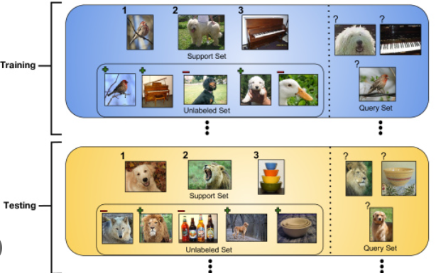
Meta Learning concept(Semi supervised few shot learning)
Meta-learning, also known as "learning to learn,“.
few-shot learning,
Semi-supervised learning

Slide 4
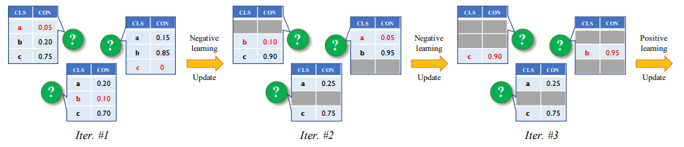
Method of sUccesSIve exClusions (MUSIC) & negative learning
Process of pseudo-labeling in SSFSL as a series of successive exclusion operations.
Relatively easy to predict which class it does not belong to based on the lowest confidence prediction score.
when all negative labels of unlabeled data are sequentially excluded and labeled, their positive pseudo-labels are also obtained.
Using small support set with positive pseudo-labels, and fully utilize the auxiliary information from both labeled base-class data and unlabeled novel-class data in SSFSL.

Slide 5
The development of novel Algorithm

